Slide 1
Program highlights
Electronics (Instrumentation & Control) Engineering a specialized branch of electronics that focuses on Sensors, Measurement, Internet of Things (IoT), Control and automation of devices or process.
In the recent times, EIC emerges as the backbone of Industry 4.0, which is the latest trend of automation and data exchange in manufacturing technologies. With the rise of smart phones/devices, sensors and instrumentation becomes an indispensable field in engineering.

Slide 2
Program highlights
B.E. in EIC started in 1979 at TIET
Program has three elective baskets;
Smart Systems,
Biomedical and
Industrial Automation
Consistent placement record around 90%
Latest curriculum as per Industry 4.0
Experienced faculty having industry/Govt. sponsored projects
Huge alumni base in national and international arena

Slide 3
Electronics (Instrumentation & Control) ENGINEERING :Placements
Consistent Placement record (%)
Respectable Average Package
The average salary package of the current batch 2022-23 is 10.7 Lakhs and placement till 31st March 2023

Slide 4
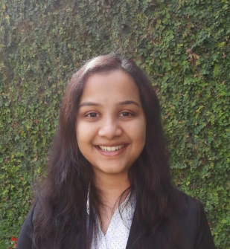
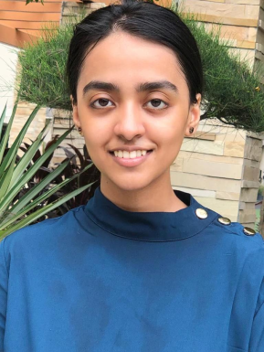
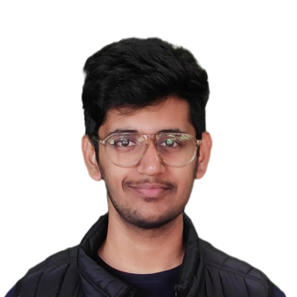
Electronics (Instrumentation & Control) ENGINEERING Placements
STAR ACHIEVERS 2022-23
Vamika Garg
Western Digital Co.
18.4 Lakh (2022-23)
Sanya Singh
AMAZON
40 Lakh (2022-23)
Pranav Mitra
American Express
18 Lakh (2022-23)
Yashonidhi Srivastava Oracle
33 Lakh (2022-23)

Slide 5
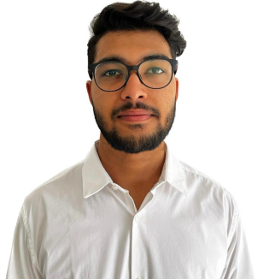
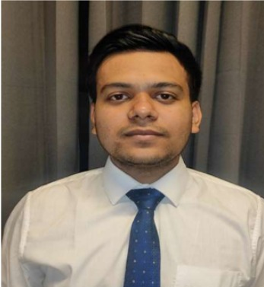
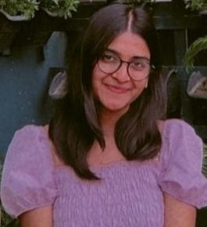
Electronics (Instrumentation & Control) ENGINEERING Placements
STAR ACHIEVERS 2022-23
Mittali Goyal
Oracle
33 Lakh (2022-23)
Kanak Khandelwal American Express
18 Lakh (2022-23)
Ashish Jha
American Express
18 Lakh (2022-23)
Ananya Singh
American Express
18 Lakh (2022-23)

Slide 6
Electronics (Instrumentation & Control) ENGINEERING Placements
STAR ACHIEVERS 2021-22
Pushpak
Mentor Graphics
20 Lakh (2021-22)
Kalash Pandey
Samsung R&D
21 Lakh (2021-22)
Saumya Sharma
Procter & Gamble
16 lakhs
Isha
BlackRock
18 Lakh (2021-22)
Sparsh Gupta
NXP Semiconductor
18 Lakh (2021-22)

Slide 7
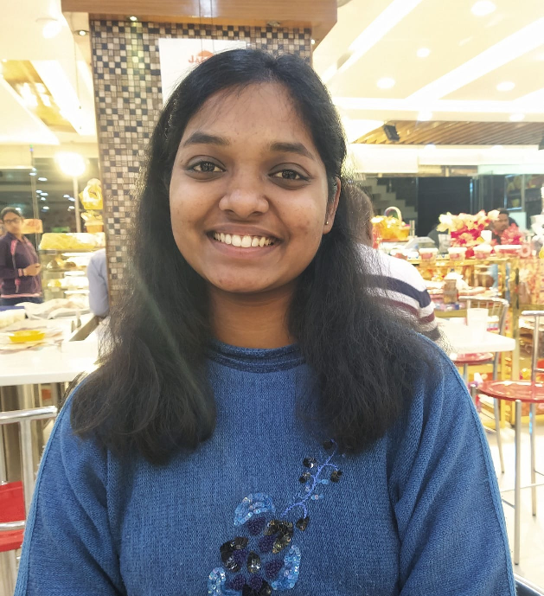
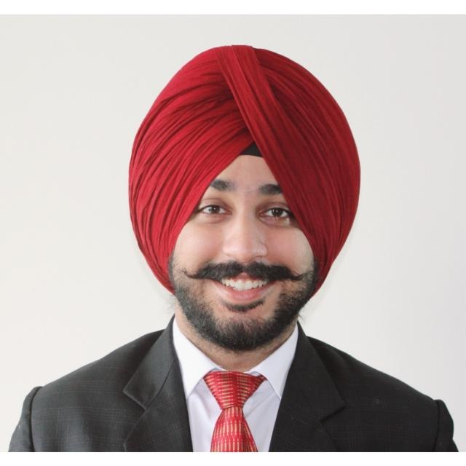
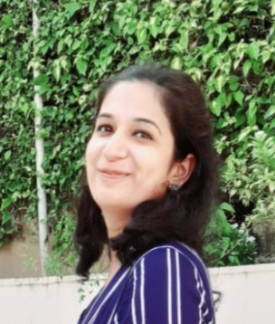
Electronics (Instrumentation & Control) ENGINEERING Placements
STAR ACHIEVERS 2020, 2021
Manasvani Sharma
Amazon Technologies
20 Lakh (2019-20)
Nitika Guptra
ARM
14 Lakh (2020-2021)
Rajeshwar Singh
Bain & Co.
12 Lakh (2020-2021)
Alisha Malhotra
Mentor Graphics
18 Lakh (2019-20)

Slide 8
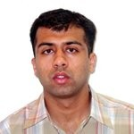
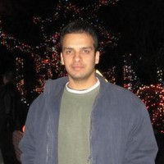
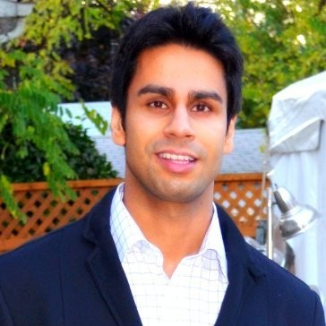
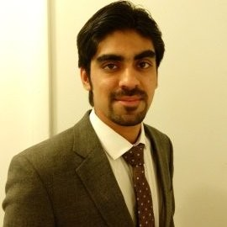
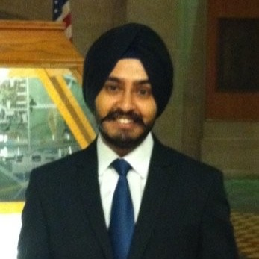
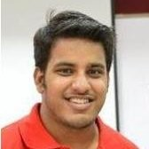
Star Achievers
Harsh Setia
(B.E. EIC 2000-04)
Director R&D
Samsung, Bangaluru
Arjun Gill
(B.E. EIC 2004-08)
Hardware Engineer
Intel, USA
Antarpreet Singh
(B.E. EIC 2003-07) Hardware Engineer
Google, USA
Akashvir Mann
(B.E. EIC 2004-08)
Sr. Product Manager Amazon, USA
Suresh Malhotra
(B.E. EIC 2008-12)
Product Manager at Amazon, USA
Ravik Hasija
(B.E. EIC 2009-13)
Software Eng -II Microsoft, USA
Pushpinder Singh
(B.E. EIC 2010-14)
Software Eng -II Apple, USA
Jatin Arora (B.E. EIC 2012-16)
Design Engineer NXP, India

Slide 9
Electronics (Instrumentation & Control) ENGINEERING Placements
STAR ACHIEVER
Kalash Pandey
EIC 2022 graduate
SAMSUNG R&D: 21 Lakh
Mentor Graphics 20 Lakh
ARM : 18 Lakh
Multiple OFFERS

Slide 10
Electronics (Instrumentation & Control) ENGINEERING Placements
STAR ACHIEVERS
Alisha Malhotra
Overall Institute Topper 2021
Awarded with President Medal
President Medal!

Slide 11
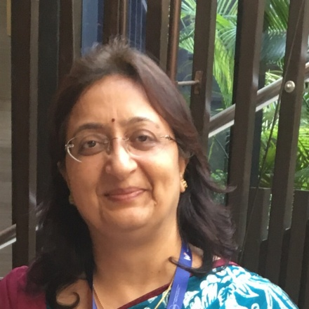
Department’s Strength
Jasm V. Chandran
(1985-89)
Director
Alliances Kryon, Bengaluru
Sonia Madan
(1986-90)
GM, Engineers India Ltd.
New Delhi
Jasmeet Singh
(2003-07)
Country Manager
Tiny-Mesh, Chandigarh
Surbhi Garg
(2008-12)
IAS Officer
New Delhi

Slide 12
Global Corporate Leaders
Apple Inc.
Antarpreet Singh
(B.E. EIC 2003-07) Hardware Engineer
Google, USA
Ravik Hasija
(B.E. EIC 2009-13)
Software Eng –II Microsoft, USA
Pushpinder Singh
(B.E. EIC 2010-14)
Manager (Engg)
Apple, USA
Suresh Malhotra
(B.E. EIC 2008-12)
Product Manager,
Amazon, USA

Slide 13
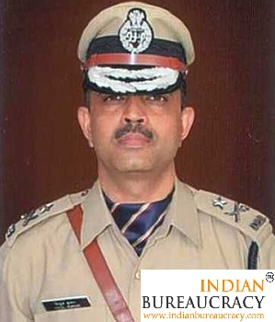
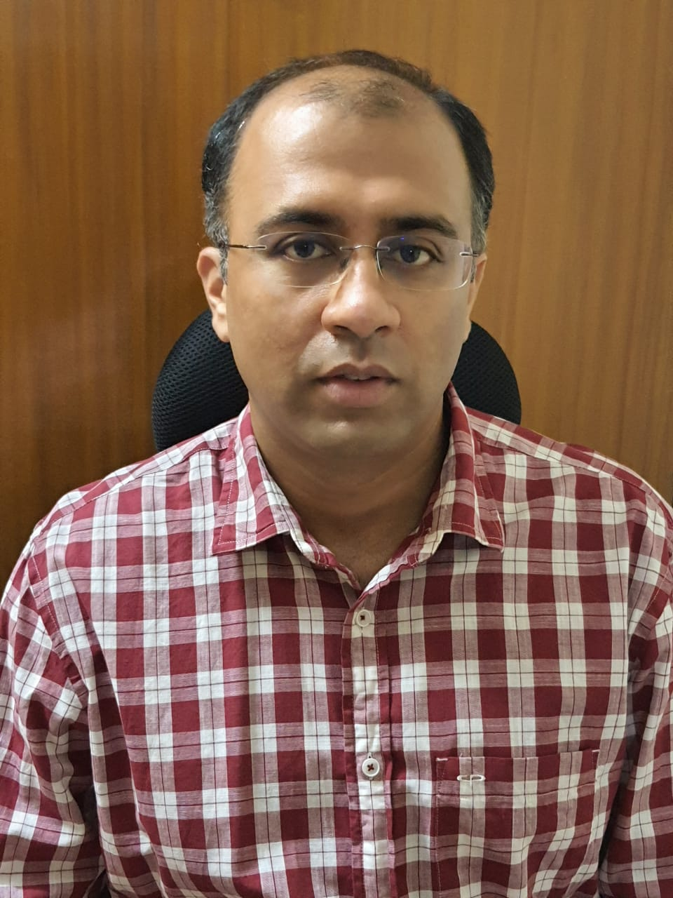
Electronics (Instrumentation & Control) ENGINEERING Placements
STAR ALUMNI
Mr. Nirlep Singh Rai
(1982-1986) EIC
Chief Managing Director,
NFL, New Delhi
Mr. Vitul Kumar
(1984-1988) EIC
ADGP
Uttar Pradesh
Mr. Harsh Setia
(1999-2003) EIC
Director,
SAMSUNG R&D
Bangaluru

