Slide 1

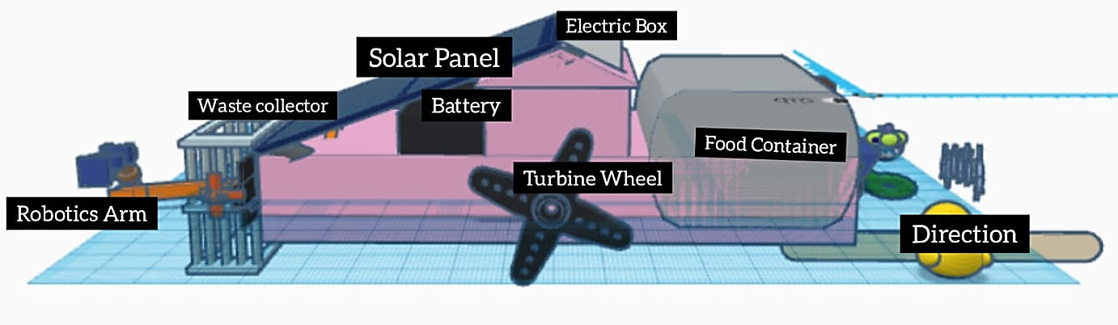
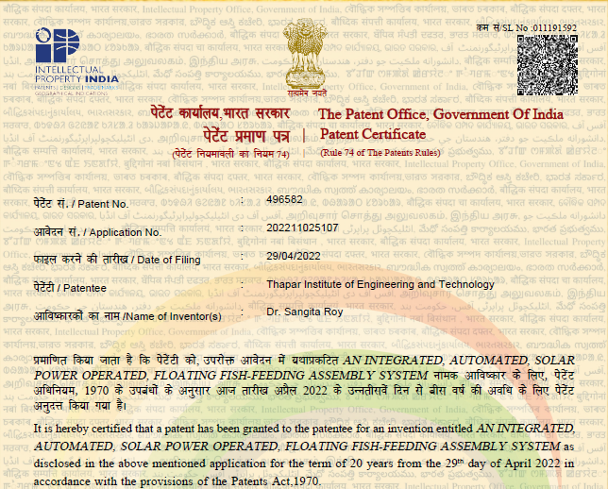
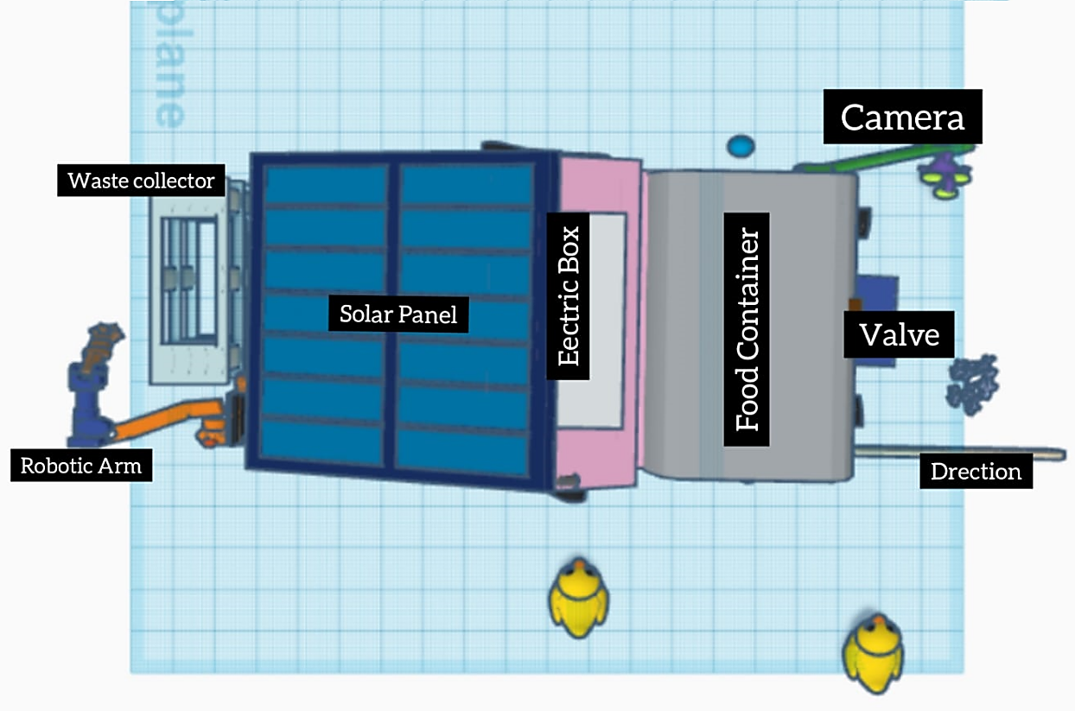
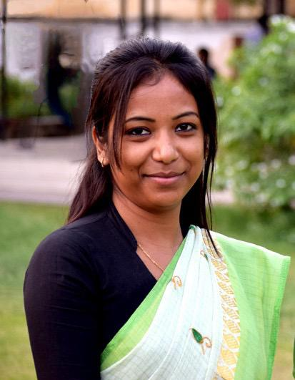
AN INTEGRATED, AUTOMATED, SOLAR POWER OPERATED, FLOATING FISH-FEEDING ASSEMBLY SYSTEM
Sustainable and cost effective
Solar-powered Automation
Backup Power and Redundancy
Automated Feeding System
IoT based Smart Control
Air Diffusion Aeration
Optimized Feeding Process
Water Quality Monitoring
Weeds and Garbage Collection
Dr. Sangita Roy
Department of Computer Science and Engineering
Thapar Institute of Engineering and Technology, Patiala, Punjab, India
Home page: https://sites.google.com/view/sangitaroy
Contact email address:
iprcell@thapar.edu & dorsp@thapar.edu

