Slide 1

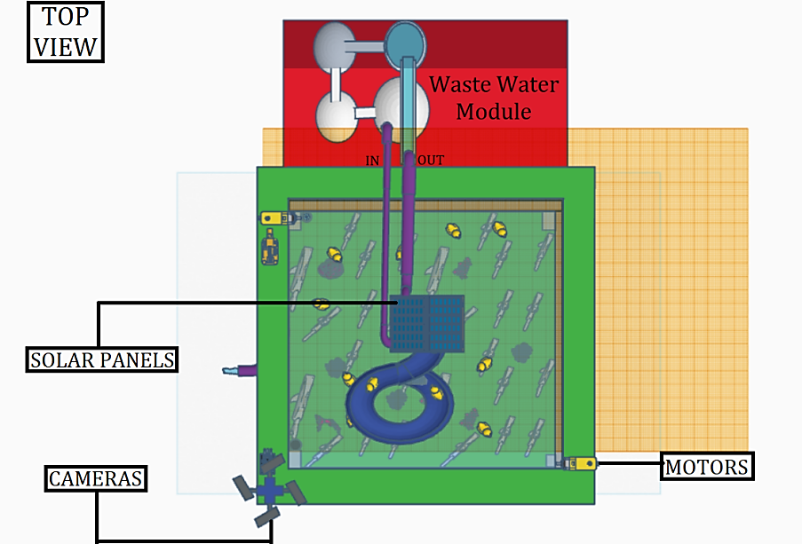
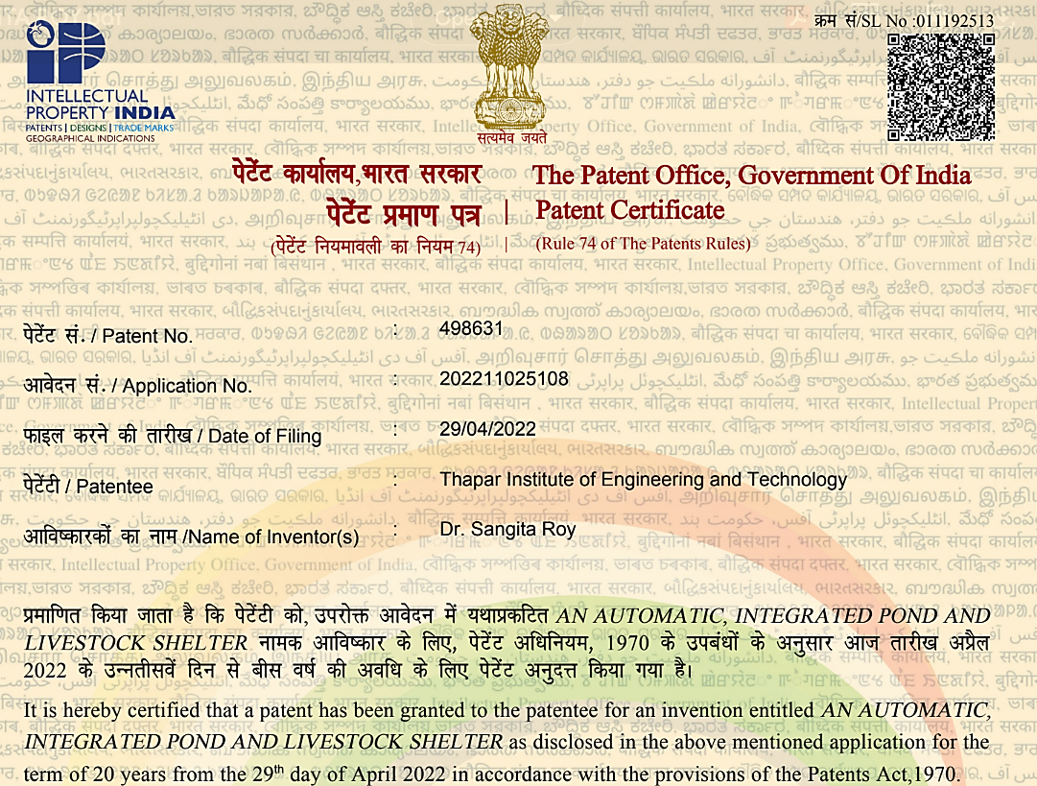
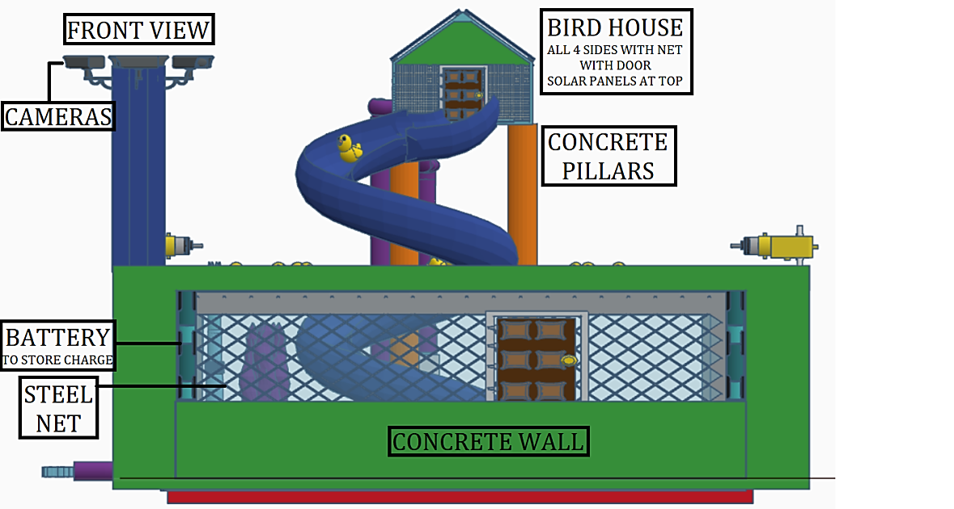
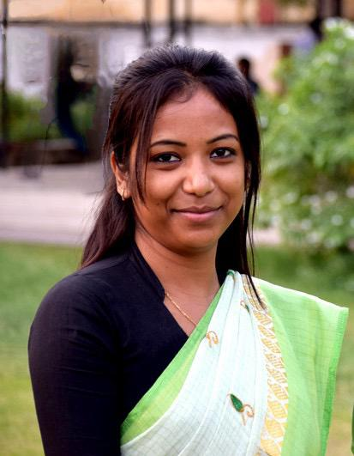
AN AUTOMATIC, INTEGRATED POND AND LIVESTOCK SHELTER
24/7 monitoring
Water Quality and Temperature
Livestock Health
Solar-powered Automation
Protection Against Flood
Waste Water Management
Automated Feeding System
Predator Management
Security and Surveillance
IoT Connectivity
Data Analytics
Dr. Sangita Roy
Department of Computer Science and Engineering
Thapar Institute of Engineering and Technology, Patiala, Punjab, India
Home page: https://sites.google.com/view/sangitaroy
Contact email address:
iprcell@thapar.edu & dorsp@thapar.edu

